Slide 1
Smart Home Automation System Using ESP32 & Blynk
IoT-Based Home Light Control System Using ESP32 and Blynk Cloud Platform
Amna (23-NTU-CS-1013)
Aleena Shahzad (23-NTU-CS-1009)

Slide 2
Introduction
The Internet of Things (IoT) is a modern technology in which electronic devices are connected to the internet and can be controlled remotely.
In this project, a smart light control system is designed where electric bulbs can be switched ON and OFF automatically using IoT technology. The project demonstrates how home appliances can be controlled wirelessly using a microcontroller and relay module.

Slide 3
Problem Statement
Traditional lighting systems require manual operation using wall switches.
This leads to the following issues:
Energy wastage when lights are left ON
Manual effort required every time
No remote access or automation
Inconvenience for elderly or disabled people
Therefore, there is a need for a smart and automated lighting system.

Slide 4
Objectives
To design an IoT-based smart light control system
To control AC light bulbs wirelessly
To reduce human effort and save energy
To understand the working of relay, ESP module and IoT communication
To demonstrate automation in home appliances

Slide 5
Components Used
The hardware components used in the project are:
ESP32 / NodeMCU microcontroller
2-Channel or 4-Channel Relay Module
AC Bulbs and Holders
Jumper wires
Power supply cable and plug
Smartphone for controlling lights
All components are low-cost and easily available.
The software part consists of:
Visual Studio Code
Required libraries for ESP module
Wi-Fi configuration
Code for relay control
The program continuously listens for input signals and responds in real time.

Slide 6
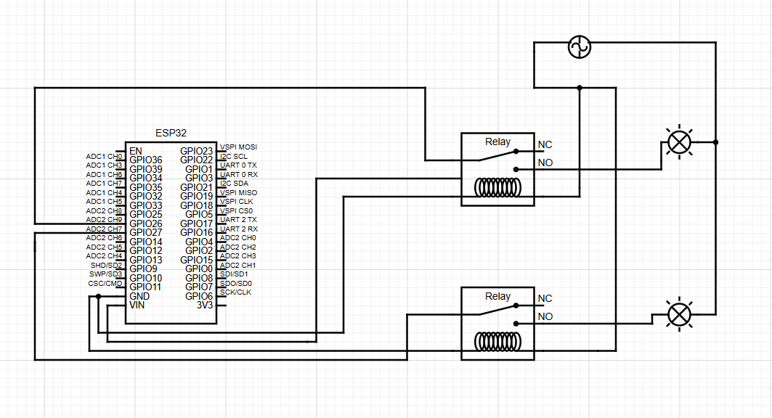
Circuit Diagram
ESP32 is connected to relay input pins
Relay output is connected to AC bulb circuit
Neutral wire remains common
Live wire is switched using relay
Power plug provides AC supply
When ESP sends HIGH/LOW signal, relay opens or closes the circuit and the bulb turns ON or OFF.

Slide 7
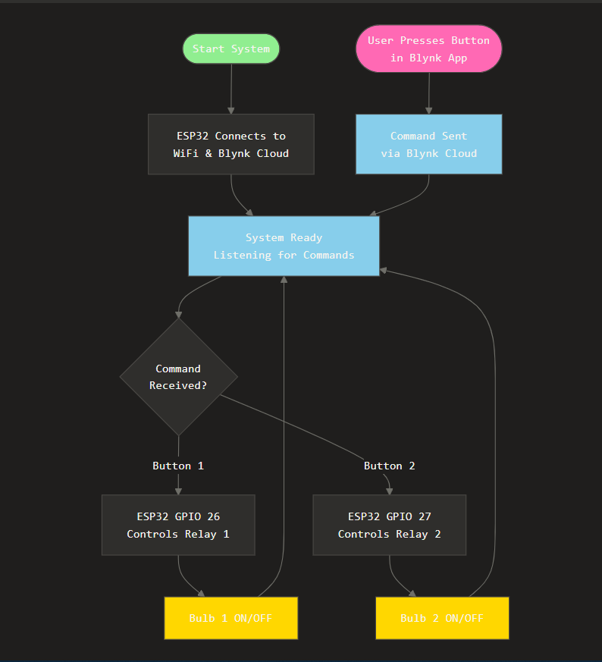
Working Principle
The working process is as follows:
ESP32 connects to Wi-Fi network
User sends control command through mobile app / web dashboard
Microcontroller receives the signal
Relay switches the AC circuit
Light bulbs turn ON or OFF accordingly
Thus remote lighting control is successfully achieved.

Slide 8
Applications
The project has wide applications such as:
Smart homes
Offices and classrooms
Hospitals
Hotels
Industries
Energy-efficient buildings
It can be extended to fan, TV, AC and other appliances.

Slide 9
Advantages
Future Scope
Saves electricity
Reduces human effort
Easy to install
Low cost solution
Remote operation possible
Improves comfort and convenience
Future improvements may include:
Mobile app-based control
Voice control using Google Assistant or Alexa
Automatic operation using motion sensors
Power usage monitoring
Scheduling of lights
Safety Measures
Avoid touching bare wires
Provide insulation tape
Use correct relay module
Handle AC power carefully
Keep water away
Always test with caution

Slide 10
Thank You
Questions are welcome 👍

